Slide 1
NONRESIDENT ALIEN INCOME TAX BASICS
PRESENTED AT THE NAFSA REGIONAL CONFERENCE SESSIONS FALL 2014 BY
GARY ENGLER, CPA
(updated with all available 2014 tax forms , information, links, and thresholds, as of January 15, 2015)

Slide 2
Why File an Income Tax Return?
It is the law.
Compliance with US Visa requirements
If you earned more than a minimum amount of Income
To report certain foreign assets if you are a Resident tax payer.
Get a refund of withheld taxes
Pay additional taxes if they are owed.

Slide 3
Which US Tax Form Do I file?
RESIDENT:
  US CITIZEN
  GREEN CARD,
  Resident under Substantial Presence Test (Generally)
    J-1 HERE IN 3 OR MORE CALENDAR YEARS (IN LAST 6 YEARS).
    F-1 HERE MORE THAN 5 YEARS.
  FILES FORM 1040, 1040A (NO GOOD FOR TREATY EXEMPTIONS) OR 1040EZ (ONLY WAGES, NO TREATY)
NONRESIDENT:
  Teacher of Trainee in US 2 or Less Calendar years (in the past 6)
  Student here in 5 or less calendar Years.
  FILES 1040 NR-EZ (ONLY WAGES & SCHOLARSHIP INCOME) OR 1040NR (ALL TYPES OF INCOME)

Slide 4
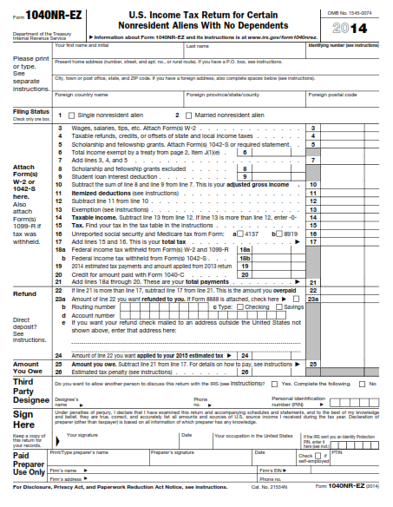

Slide 5
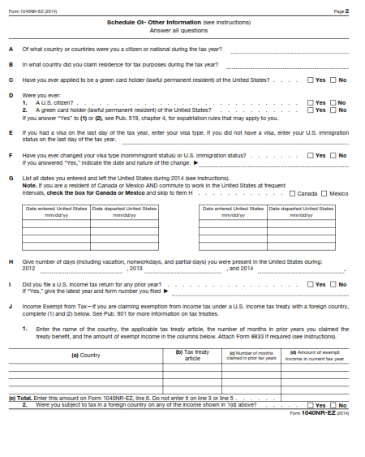

Slide 6
FILING THRESHOLDS – 2014 tax year
RESIDENT = $10,150 (Generally) Composed of
  Personal exemption of $3,950 +
  Standard Deduction of $6,200
Nonresident =
  $3,950 (Generally) for effectively connected income. (No Standard Deduction)
  $1 for not effectively connected income. (passive US source income)
  Unless correct withholding already paid
Note: If taxpayer is eligible for tax treaty, a tax return must be filed to claim the benefits of the treaty.
DEPENDENTS
  RESIDENT: CAN CLAIM DEPENDENTS ON TAX RETURN
  NONRESIDENTS : CANNOT CLAIM DEPENDENTS ON TAX RETURN EXCEPT FOR RESIDENTS OF
    *CANADA,
    *MEXICO
    *REPUBLIC OF KOREA, AND
    *INDIA, and then,
      SPECIFIC CONDITIONS MUST BE MET. EACH DEPENDENT MUST HAVE EITHER A SOCIAL SECURITY NUMBER OR AN ITIN.

Slide 7
Residents For Tax Purposes
Foreigners reporting income like US Citizens
Benefit of Standard Deduction
Benefit from Education Credits
Benefit from Earned Income Credit
Report to IRS all Worldwide Income
Report Foreign Bank Accounts if >$10000
Report Foreign Financial Assets over higher thresholds.

Slide 8
Common Misconceptions
Eligibility for Treaty Benefits exempts one from Filing a Tax Return
Nonresident aliens are eligible for Education Credits
Nonresident aliens are eligible for the Earned Income Credit
Nonresident aliens can use Turbo Tax, H & R Block online, Taxslayer, etc
It is ok not to file the 8843.
Definition of word “Resident”
  Immigration definition
  US Income Tax Definition
  Tuition purposes definition
  English language definition
  States often use “domicile” definition

Slide 9
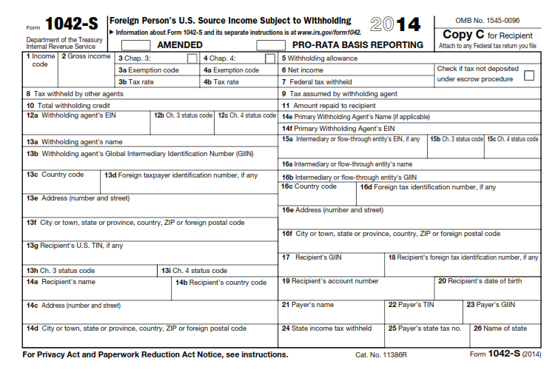

Slide 10
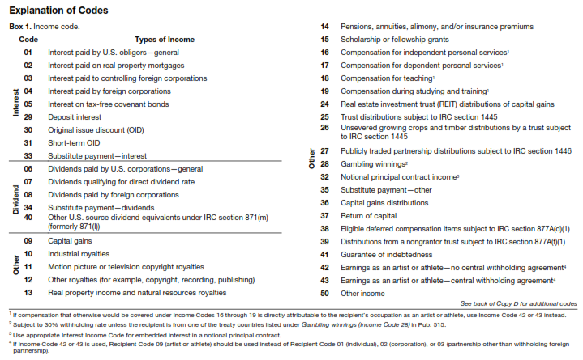

Slide 11
Treaty Benefits
Exempt income for foreigners
65+ Countries with the USA
Scholarship and Fellowship Grants
Teachers & Researchers
Studying & Training
India
China
Canada

Slide 12
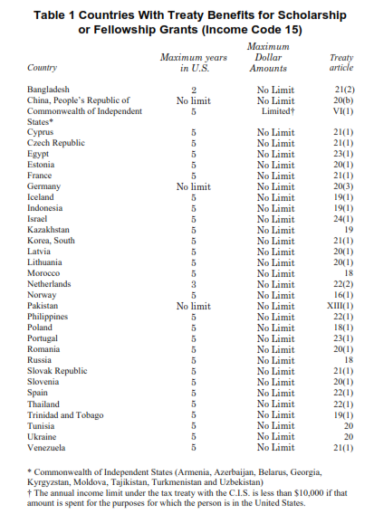

Slide 13
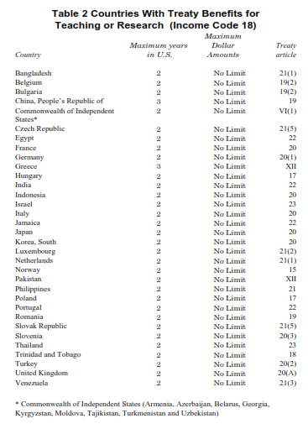

Slide 14
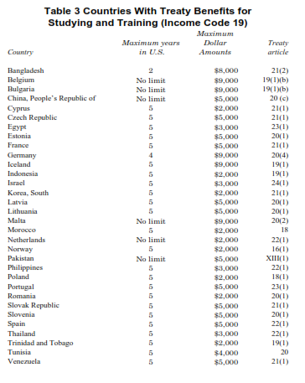

Slide 15
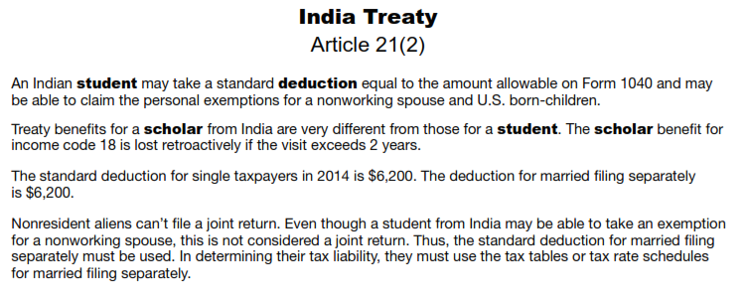

Slide 16
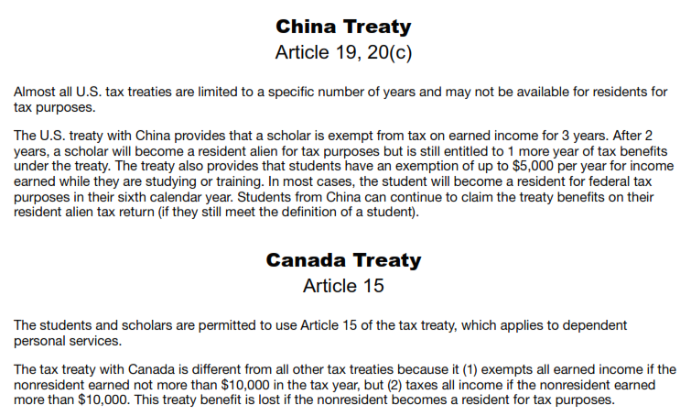

Slide 17
Income Tax Preparation Options for Nonresident Alien Tax Returns
Software
  Windstar (Foreign National Tax Resource) w/ or without Live Webinar
  Glacier
Online software – does not support NRA tax forms
  H & R Block at Home
  Turbotax
  Taxslayer
Other options
  VITA sites
  Store fronts (H&R Block, Jackson Hewitt)
  CPA (yours truly) via secure server
  Self-prepared

Slide 18
Withheld Social Security and Medicare – How to get it back
Contact Employer first (by email/mail better than verbal)
Form 843
Supplemental form 8316
Publication 519 - Page 43 “Refund of Taxes Withheld in Error”

Slide 19
ITIN’s – What do we do now?
Discussion
ITIN Policy Changes Summary for 2013 at http://www.irs.gov/Individuals/ITIN-Policy-Change-Summary-for-2013.
Educational institutions follow SEVP approved process issued 10/2/2012
  Sample of Certification Letter http://www.irs.gov/uac/Newsroom/Sample-of-Certification-Letter
  Special Instructions for Student and Exchange Visitor Progam (SEVP) Institutions http://www.irs.gov/uac/Newsroom/Special-Instructions-for-Student-and-Exchange-Visitor-Program-(SEVP)-Institutions
  IRS Clarifies Temporary ITIN Application Requirements for…and Many Foreign Students http://www.irs.gov/uac/Newsroom/IRS-Clarifies-Temporary-ITIN-Application-Requirements-for-Noncitizens-with-Tax-Extensions-and-Many-Foreign-Students
  Nafsa Summary of Itin Procedures as of November 13, 2014. http://www.nafsa.org/Find_Resources/Supporting_International_Students_And_Scholars/ISS_Issues/ITIN_Procedures_For_Scholarship,_Fellowship,_and_Grant_Recipients/

Slide 20
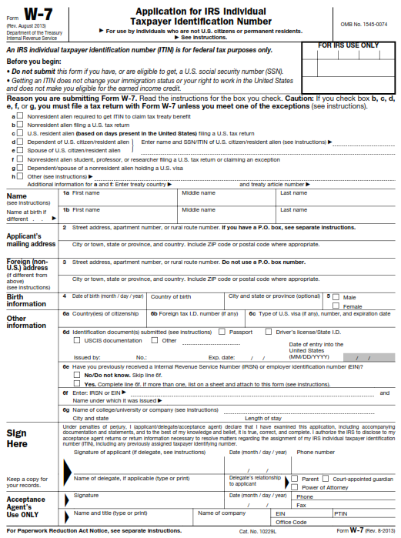

Slide 21
HELP WITH ITIN APPLICATIONS
For problems: contact Nancy Lanier at IRS Nancy.G.Lanier@irs.gov. Nancy is the Senior Program Analyst for the Taxpayer Advocate Service at the Austin Service Center. She is a “Subject Matter Expert” regarding ITINS.
If ITIN not used on Federal Income tax return for five consectutive years, the ITIN will expire.
Top twelve most common errors in SEVP-approved colleges submitted ITIN applications:
  Tax return attached to ITIN application. If tax return attached, the application treated as though student applied themselves, in which case original docs need to be submitted.
  All questions on W-7 not answered.
  Student name on W-7 doesn’t match passport exactly.
  Not wording the Sevis Letter as per published “Sample of Certification Letter.”
  Giving the Sevis letter to students to send in with application themselves.
  Expired ID docs or passport copies with no signature.
  Attaching notarized copies of documents to applications.
  Not checking both boxes f & h for spouses and dependents of students
  Putting a PO Box or In Care of Address in the foreign address field.
  Not attaching a copy of the I-20 or DS-2019 for each student.
  Telling students to go to a TAC office or CAA office
  Not telling students to notify school when they receive a notice from the IRS.
Options for verification of key documents at http://www.irs.gov/Individuals/ITIN-Policy-Change-Summary-for-2013
  Taxpayer assistance centers
  Tax Attaches
  Low-Income Taxpayer Clinics
  Vita Centers
  Certifying Acceptance Agents

Slide 22
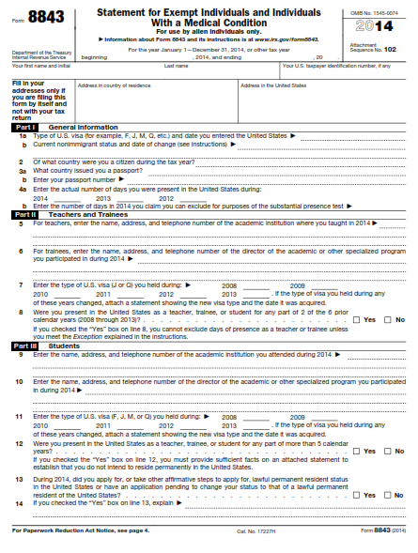

Slide 23
Form 8843 - Statement for Exempt Individuals – Do we really have to file this form?
No monetary penalty for not filing this form.
When required:
  If filing 1040nr or 1040nrez
  If not filing 1040nr or 1040nrez
  If exempting days to count towards the substantial presence test
Visa says comply with all US laws
  Tax laws are US laws
Failure to file does not make one a Resident.
How to show proof of tax compliance if later choose to apply for Green Card?

Slide 24
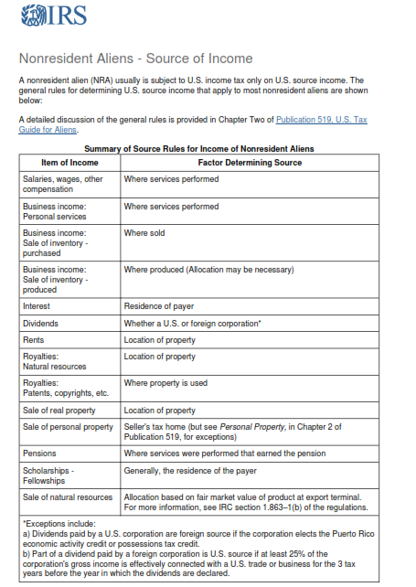

Slide 26
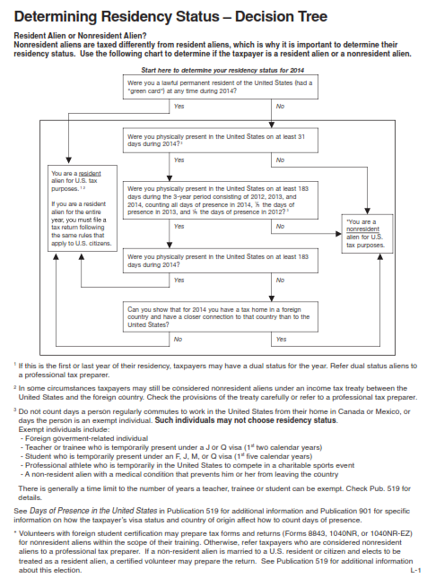

Slide 27
USEFUL LINKS
IRS PAGE FOR FOREIGN STUDENTS & SCHOLARS http://www.irs.gov/Individuals/International-Taxpayers/Foreign-Students-and-Scholars
IRS PAGE SUBSTANTIAL PRESENCE TEST http://www.irs.gov/Individuals/International-Taxpayers/Substantial-Presence-Test
HOW DOES A NONRESIDENT ALIEN COMPLETE A FORM W-4? http://www.irs.gov/pub/irs-pdf/n1392.pdf
US TAX GUIDE FOR ALIENS (2013) http://www.irs.gov/publications/p519/

Slide 28
Gary Engler CPA Services Offered
Low Priced, Web Based, CPA prepared, US & State Income Tax Returns
Webinars & Seminars for both Advisors and Int’l Students/Scholars
  US FORM 1040NR INCOME TAX PREPARATION WORKSHOP FOR STUDENTS
  INCOME TAX INFORMATION FOR ADVISORS
  INCOME TAX INFORMATION FOR STUDENTS
  CALIFORNIA FORM 540NR INCOME TAX PREPARATION WORKSHOP FOR STUDENTS
Prepare Forms 1042 & 1042-s – US source income & withholding
Advise Institutions regarding Compliance with US Income tax Regs
Website Info/Resources for Advisors & Students/Scholars at www.englercpa.com

